Slide 1
Software Development 3
GUIs

Slide 2
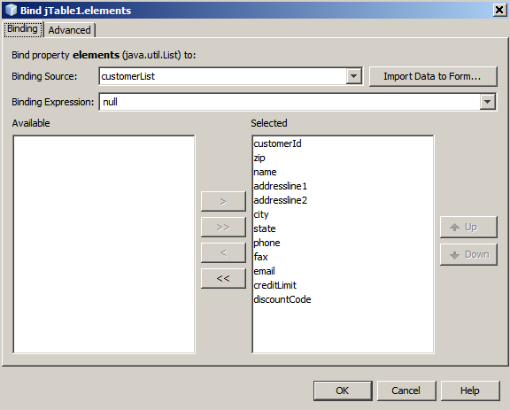
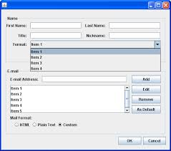
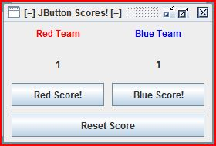
Graphical User Interfaces
Graphical User Interface
Has graphics for the user to “interface” (use) a system
In Java often windows
Swing library

Slide 3
Swing Overview
Swing contains group of feature to help build GUIs
Swing is part of the Java Foundation Classes (JFC)
Provides all of the components – buttons, tables, labels…
Swing was the code name of the project (unofficial name but frequently used). It's immortalized in the package names for the Swing API, which begin with javax.swing
Used by importing the package: import javax.swing.*;

Slide 4
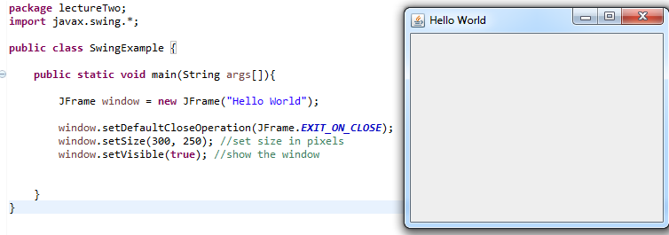
Creating a window

Slide 5
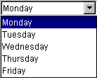

Components
Swing is a library of JAVA components which can be used to create GUIs.
“A component is an object having a graphical representation that can be displayed on the screen and that can interact with the user.”
These can be buttons, labels, scrollbars, etc.
JComboBox
JList

Slide 6
Containers
“A container is a component that can contain other components”
Earlier we created a JFrame window – a commonly used container
We can add more components to the JFrame to let the user interact with it…

Slide 7
Abstract Windowing Toolkit (AWT)
Original windowing library for Java
Basic UI Components and Containers
Native code for each OS-platform meant AWT was not portable going against one of the corner stones of the JAVA language
The biggest difference between the AWT and Swing components is that Swing components are implemented with no native code.

Slide 8
Differences between AWT and Swing
java.awt vs javax.swing
Swing buttons and labels can display images instead of, or in addition to text
Easily add or change the borders drawn around most Swing components – easy to put a box around the outside of a container or label
Swing components don’t have to be rectangular – eg round buttons
Swing lets you specify which look and feel your program’s GUI uses. AWT components always have the look and feel of the native platform

Slide 9
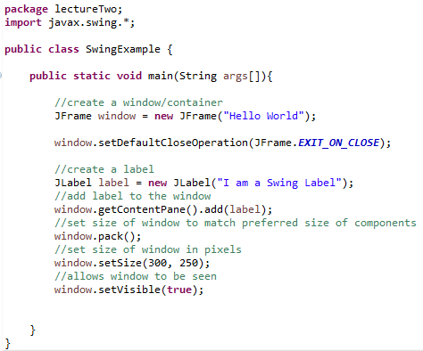
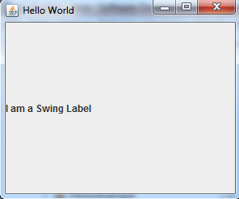
Example

Slide 10
Importing Swing and AWT
We previously imported javax.swing.* - all classes in the Swing package
Could have specified which ones: javax.swing.JFrame;
Most Swing programs will need AWT
import java.awt.*; - imports all classes
Swing components use the AWT event model for event handling – how does a component react to a button click…. (what does it do?)

Slide 11
Top Level Containers
Every program with a Swing GUI must contain one top-level Swing container
Top-level Swing container provides the support that Swing components need to perform their paining and event handling.
Our example used a JFrame – there are three types:
JFrame, JDialog, JApplet (for applets!)

Slide 12
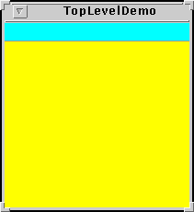
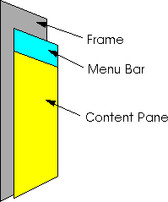
Top Level Containers

Slide 13
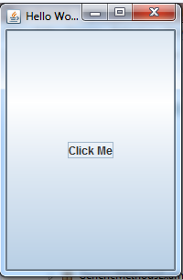
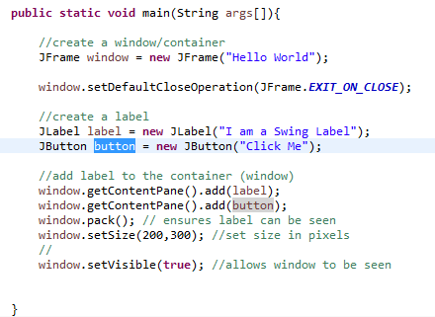
Buttons
Creating and adding the button
Button takes whole container.
Why?

Slide 14
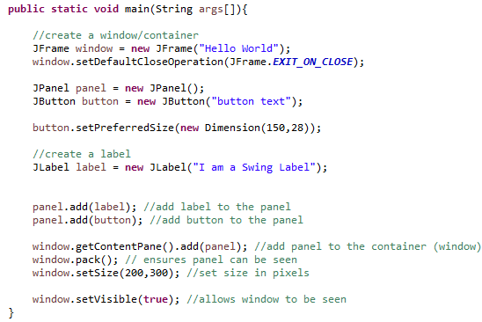
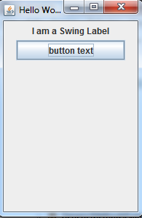
Buttons
Previous example showed the button took the whole space – need to use a panel to add multiple components.

Slide 15
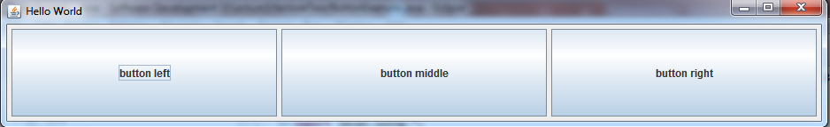
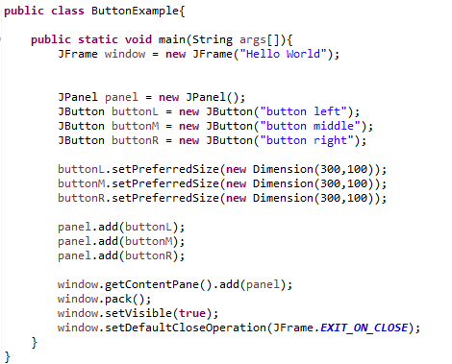
Button Layout

Slide 16
Event Driven Programming
Buttons will not do anything when they are clicked
Need to add functionality – Event Driven Programming
Button clicks: the button ‘listens’ for an event to occur (click)
Object implements the appropriate interface, is registered as an event listener on the appropriate event
We create a class that listens for events to happen to specific components

Slide 17
(Some) Listener Types
ActionListener: For receiving action events – mouse click
FocusListener: For receiving keyboard focus events on a component
KeyListener: For receiving keyboard events (keystrokes)
MouseListener: For receiving ‘interesting’ mouse events (press, release, click, enter (hover), exit (stop hovering)
MouseMotionListener: For receiving mouse motion events on a component

Slide 18
(Some) Listener Types
MouseListener: For receiving ‘interesting’ mouse events (press, release, click, enter (hover), exit (stop hovering)
MouseWheelListener: For receiving mouse wheel events on a component
WindowFocusListener: For receiving WindowEvents: WINDOW_GAINED_FOCUS, WINDOW_LOST_FOCUS
WindowListener: For receiving window events

Slide 19
Exercise
Create a class to change the text of a label saying which button was pressed…. With a ‘tester’ class to implement it
Done in class…..

Slide 20
Exercise
Create a class to change the colour of the background of the buttons depending on the button pressed… (with a main method in the same class)
Done in class…..

Slide 21
java.awt.color;
black
blue
cyan
darkGray
Gray
green
lightGray
Orange.

Slide 22
Exercise
Create a class to change which checkbox is checked (ticked)… with a main method in the same class….
Done in class…..

Slide 23
Exercise
Create a class to change the background of the buttons depending on the button pressed… (with a main method in the same class)
Done in class…..

Slide 24
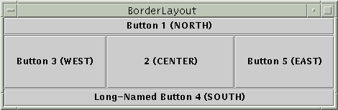
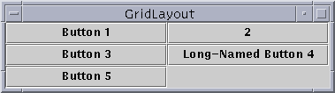
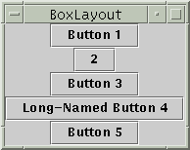

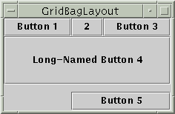
Layout Management
Five GUIs each with 5 buttons but different layouts….
Identical buttons, almost identical code, but different layout managers controlling the size and position

Slide 25
Layout Management
Layout management is the process of determining the size and position of components.
By default, each container has a layout manager -- an object that performs layout management for the components within the container.
Components can provide size and alignment hints to layout managers, but layout managers have the final say on the size and position of those components.

Slide 26
Layout Management
The Java platform supplies five commonly used layout managers: BorderLayout, BoxLayout, FlowLayout, GridBagLayout, and GridLayout.
Generally, you only ever set the layout manager of two types of containers: content panes (Like in a Jframe, which use BorderLayout by default) and JPanels (which use FlowLayout by default).
These layout managers are designed for displaying multiple components at once.

Slide 27
Layout Management
Whenever you use the add method to put a component in a container, you need to think about the layout manager.
Some layout managers, such as BorderLayout, require you to specify the component's relative position in the container, using an additional argument with the add method.
Occasionally, a layout manager such as GridBagLayout requires elaborate setup procedures. Many layout managers, however, simply place components based on the order they were added to their container.

Slide 28
Border Layout
BorderLayout is the default layout manager for every content pane
The content pane is the main container in all frames, applets, and dialogs
A BorderLayout has five areas available to hold components: north, south, east, west, and centre
All extra space is placed in the centre area

Slide 29
Border Layout
If you enlarge the window, the center area gets as much of the available space as possible.
The other areas expand only as much as necessary to fill all available space.
Often, a container uses only one or two of the areas of the BorderLayout -- just the center, or center and south, for example

Slide 30
Grid Layout
GridLayout simply makes a bunch of components equal in size and displays them in the requested number of rows and columns
A GridLayout places components in a grid of cells
Each component takes all the available space within its cell, and each cell is exactly the same size.
If you resize the GridLayout window, you'll see that the GridLayout changes the cell size so that the cells are as large as possible, given the space available to the container

Slide 31
Box Layout
BoxLayout puts components in a single row or column
It respects the components' requested maximum sizes, and also lets you align components
BoxLayout either stacks its components on top of each other (with the first component at the top) or places them in a tight row from left to right -- your choice

Slide 32
Flow Layout
FlowLayout is the default layout manager for every JPanel
FlowLayout puts components in a row, sized at their preferred size
If the horizontal space in the container is too small to put all the components in one row, FlowLayout uses multiple rows
Within each row, components are centered (the default), left-aligned, or right-aligned as specified when the FlowLayout is created

Slide 33
GridBagLayout
GridBagLayout is the most sophisticated, flexible layout manager the Java platform provides
It aligns components by placing them within a grid of cells, allowing some components to span more than one cell
The rows in the grid aren't necessarily all the same height; similarly, grid columns can have different widths
GridBagLayout places components in rectangles (cells) in a grid, and then uses the components' preferred sizes to determine how big the cells should be

